Slide 1

Predicting Flight Ticket Prices Web-Scraping/Regression
Done By:
Maitreyee Gadwe Divya Mahajan
Notes:
Hello everyone,
Our topic for the presentation is Predicting Flight Ticket Prices using Machine learning technique.
I am Maitreyee and this is a team of 2 people Maitreyee and Divya.

Slide 2

In an era of dynamic airfare fluctuations, making cost-effective decisions for travelling is very challenging.
This involves identifying the optimum time for travel and selecting the most economical flight options to their desired destinations.
Through data-driven insights, we aim to revolutionize the way individuals plan their journeys, ensuring a seamless and budget-friendly travel experience.
Our goal is to provide a ML solution that enhances the travel experience by offering insights and recommendations for budget-conscious air travel.
Goal
Notes:
In a time of unpredictable fluctuations in airfare, making cost-effective travel decisions has become difficult. To solve this issue Our goal is to To forecast flight prices by selecting optimum time for travel and then selecting the cheapest flight to the desired destination. We aspire to achieve this through a machine learning solution that enhances journeys, thus providing users with valuable recommendations and insights for a seamless and budget-conscious air travel experience.

Slide 3
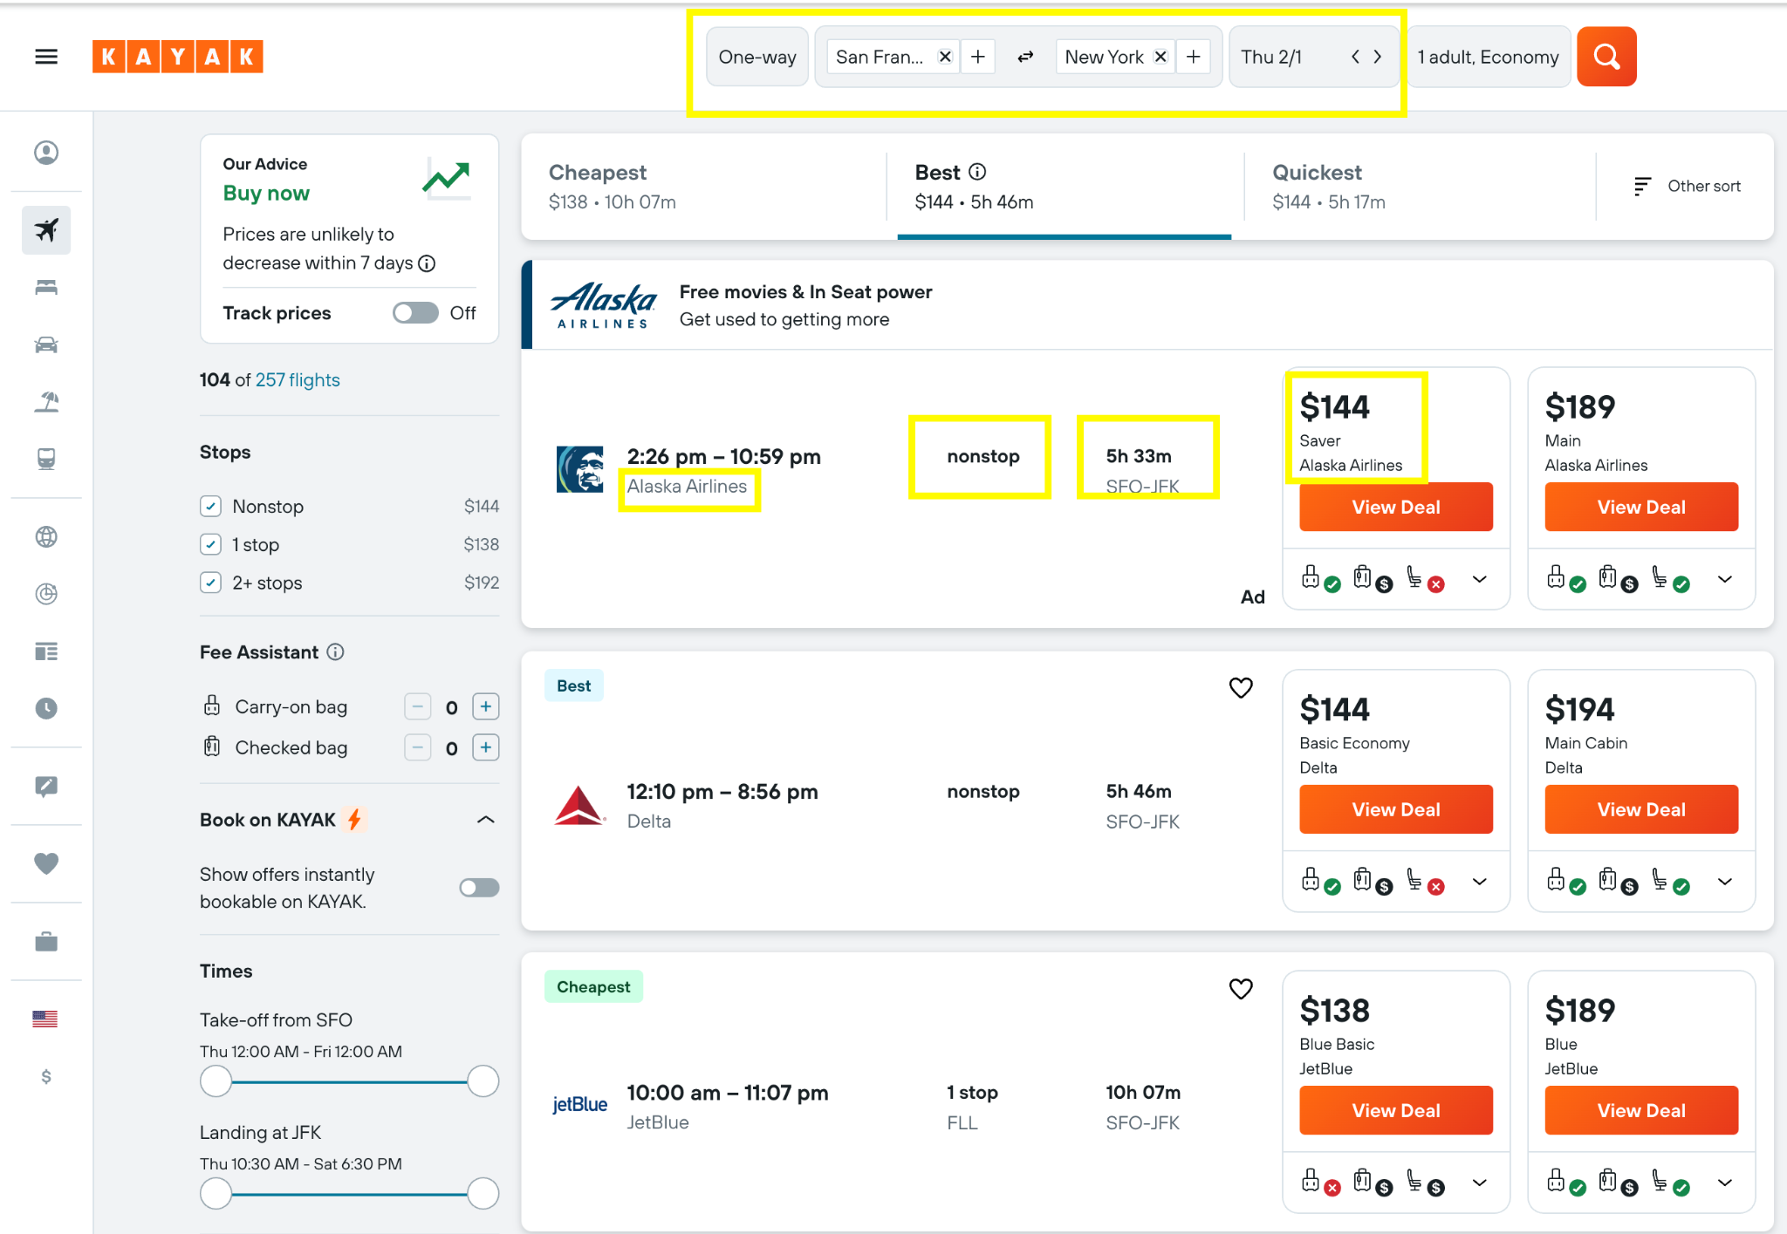
Data Collection
Scraping : https://www.kayak.com/
Source & Destination
Date (Feb, 2024)
Price
Duration
Total Stops
Airline
Notes:
The first step to achieve our goal is data collection.
Our project relies on extracting detailed data from Kayak website (https://www.kayak.com/). We have used Selenium and BeautifulSoup for web scraping. We then Gathered data for 12 specific routes from Kayak for dates between February 1, 2024, and April 30, 2024. We organised the data into CSV files for each route.
This dataset includes features like Source & Destination, Date of flight scheduled, Price, Duration, Total Stops and Airline name serving as a backbone for model adaptability.

Slide 4
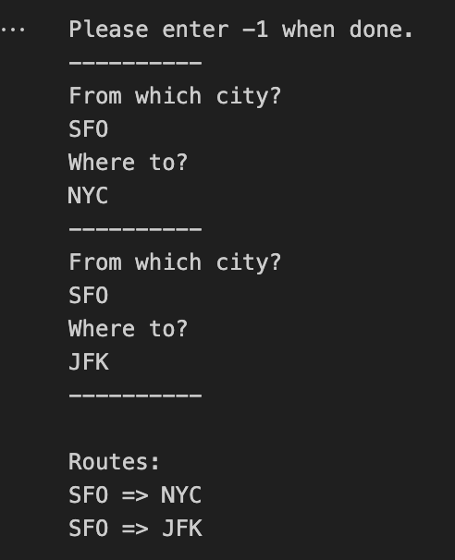
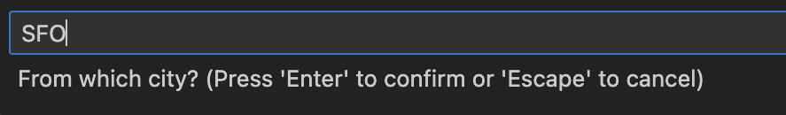

Scraping Tool
Notes:
These are some of the screenshots taken during the scraping process. We have used a User-interactive scraping that involved allowing users to input routes and dates as shown in the pictures.

Slide 5

Scraped Routes
Notes:
For the purpose of this project we have scraped routes for these 4 places namely Moscow, New York, Paris, and Riyadh.

Slide 6
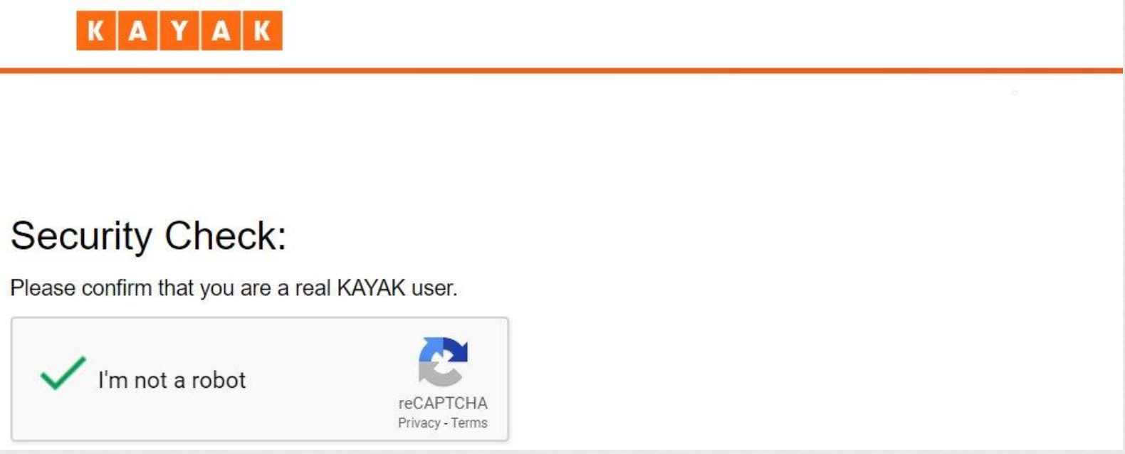
Problems Faced
Alert the user to go solve the captcha and resume scraping.
Notes:
While scraping we faced multiple challenges like there was a captcha that the website had employed so we had to Alert the user to solve the captcha so that the code could resume scraping.

Slide 7
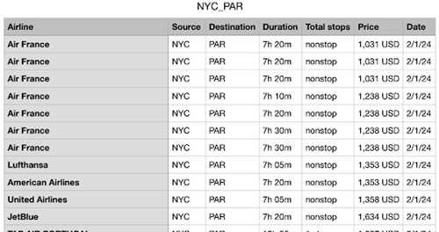
Data Collection
In total, the data consists of 55,363 rows and 7 columns.
Notes:
Our scraping efforts yielded a dataset covering data from February 1, 2024, to April 30, 2024 as shown in the figure. With detailed flight information for 12 specific routes stored in CSV files, this dataset is a cornerstone for training and refining predictive models.

Slide 8
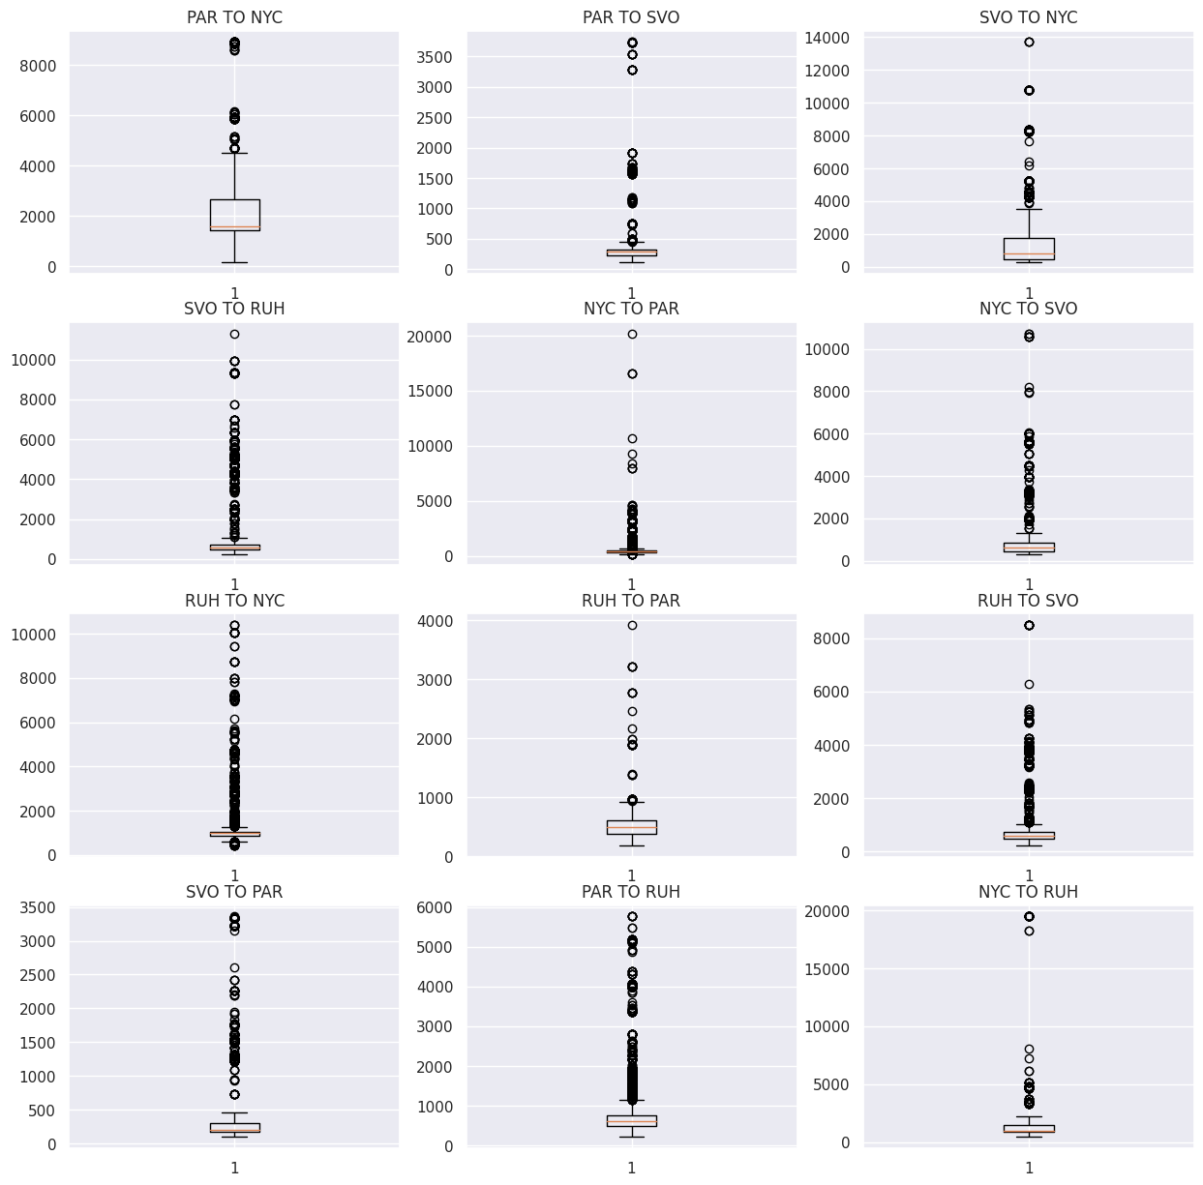
Data Pre-Processing
Notes:
After collecting the data, We used a rigorous cleaning process, by employing the Interquartile Range method, to improve dataset accuracy.
To achieve this :
“ We first Studied the Outliers “
where we Explored and visualized potential outliers using boxplots.
In this analysis, a 4x3 subplot grid visually presents potential outliers in flight prices across diverse routes. Matplotlib's boxplot function, generated boxplots using the 'Price' column from the DataFrame collection. Each subplot corresponds to a specific route, aiding easy identification with titles indicating source and destination cities. This visual approach effectively highlights outliers as data points extending beyond the box-and-whisker plots. This method facilitates clear detection and assessment of their deviation from the median price distribution for each route.

Slide 9
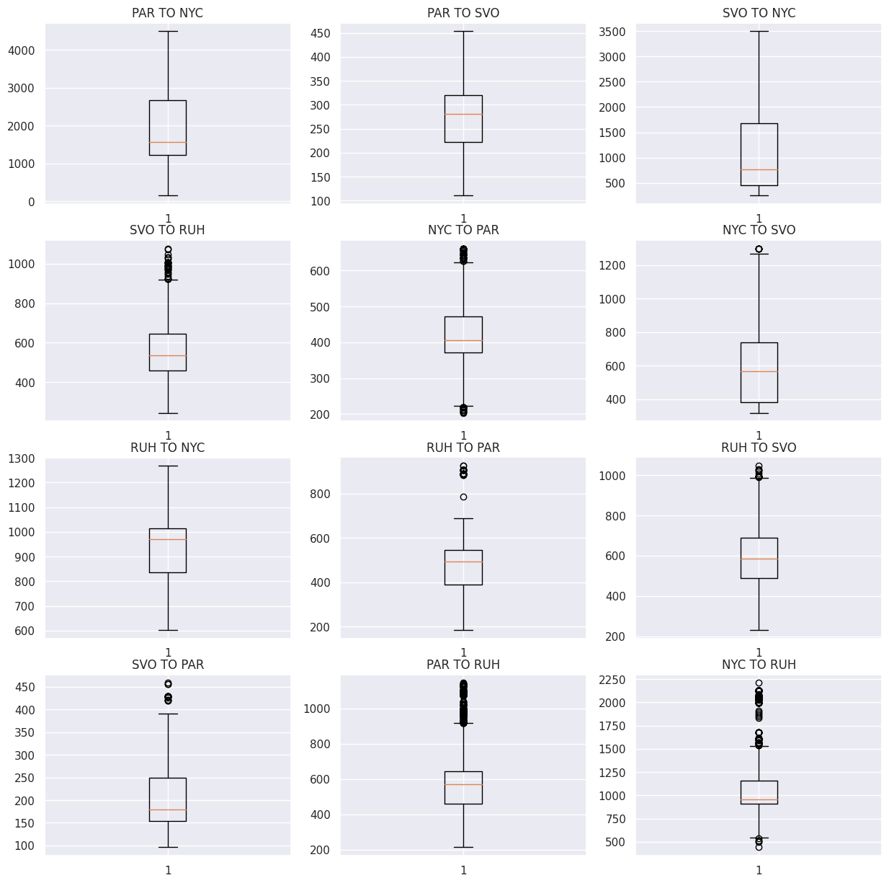
Data Pre-Processing
Notes:
"We then worked on Outlier Handling using Interquartile Range (IQR)"
In this phase, we employ the Interquartile Range (IQR) method to identify and remove outliers from flight price data across various routes. The process involves establishing lower and upper bounds, creating boolean masks to filter outliers, and replacing them with 'NaN'. The cleaned datasets are then reindexed, ensuring organized and consistent structures post-outlier removal.

Slide 10
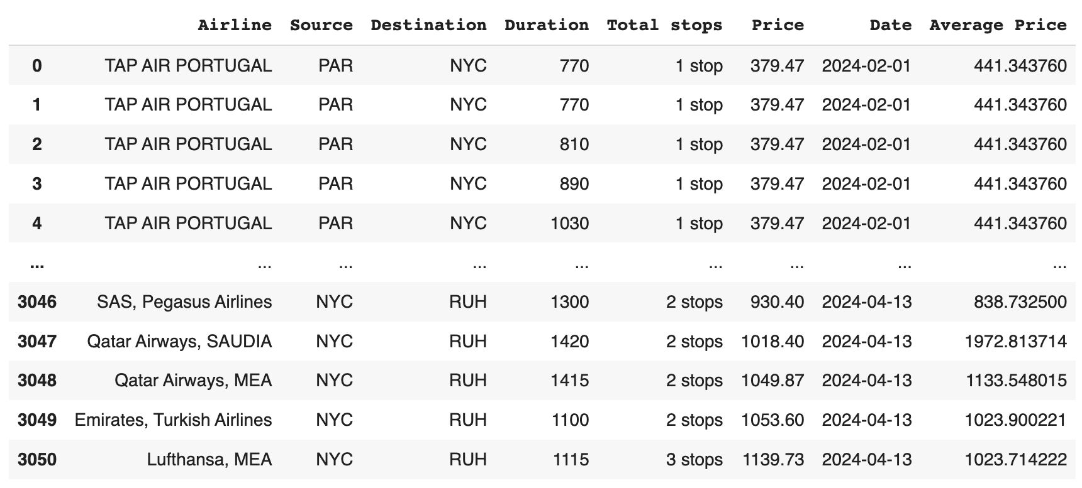
Data Pre-Processing
Notes:
The resulting cleaned and updated DataFrames are displayed in the slide, showcasing the effect of outlier removal on the flight price data across multiple routes.

Slide 11
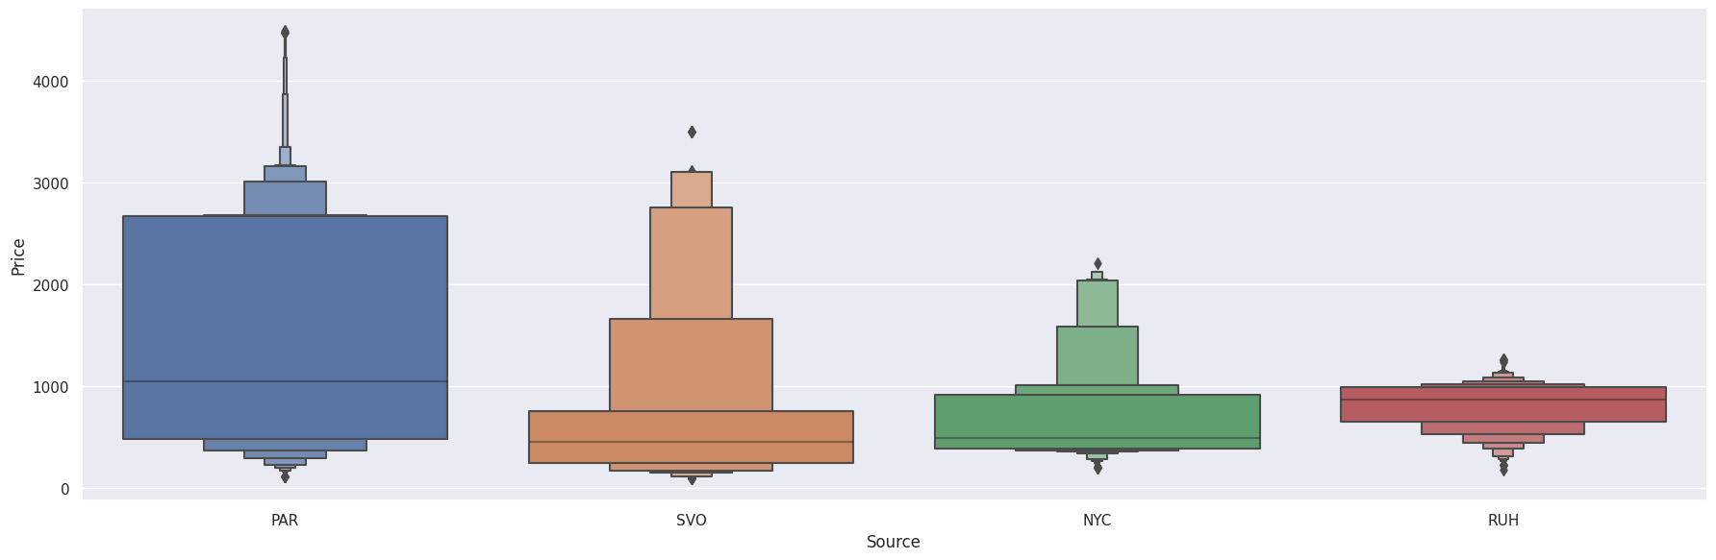
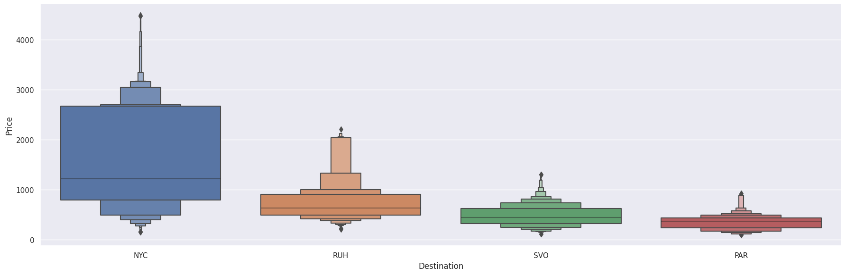
Data Pre-Processing
Notes:
In the process of preparing a dataset for regression modeling, categorical data encoding was essential, particularly for columns such as Source, Destination, and Total Stops. One-hot encoding was applied to the Source and Destination columns, converting them into numerical representations. The most frequent sources were Paris (PAR), New York City (NYC), Riyadh (RUH), and Sheremetyevo (SVO), with corresponding counts provided.
Similarly, for the Destination column, NYC emerged as the predominant destination, followed by RUH, PAR, and SVO.

Slide 12
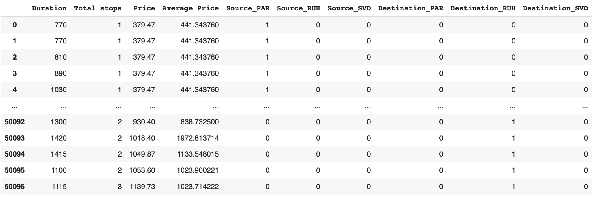
Data Pre-Processing
Notes:
As shown in the figure the Total Stops column, representing the number of stops in flights, was encoded to facilitate compatibility with regression models. The resulting dataset, named 'final_df,' includes critical numerical features such as Duration, Total Stops, Price, Average Price, as well as the encoded columns for both Source and Destination.

Slide 13
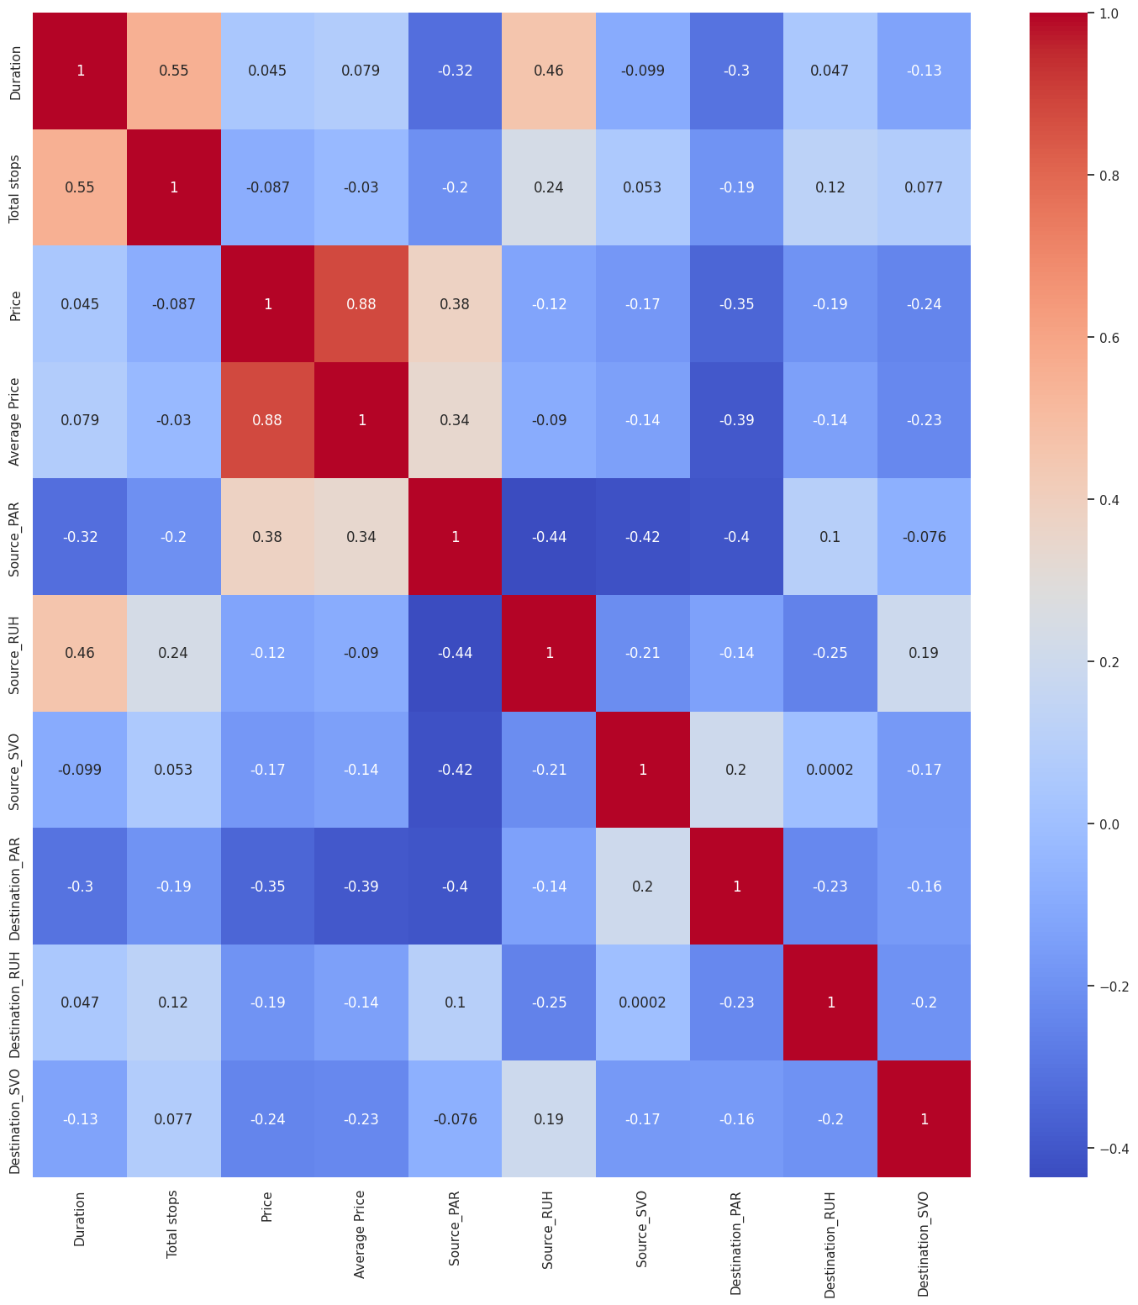
Features Analysis
Source (4)
Destination (4)
Total Stops
Average Price per Airline
Duration
Price
Notes:
Feature Analysis involves a thorough examination of attributes or features in a dataset to understand their relevance and impact on predicting the target variable. The process includes correlation analysis matrix between various features in our dataset. Each value in the matrix denotes the correlation coefficient between two respective features, ranging from -1 to 1.
Our observations were that
· There is a moderate positive correlation of approximately 0.55 between the duration of the flight and the total number of stops. This suggests that flights with longer durations tend to have more stops, which is intuitive as longer flights often require layovers or multiple stops.
· The correlation between the actual price and the average price is quite strong, with a coefficient of around 0.88. This implies that the actual price and the average price are highly positively correlated, indicating that they tend to move together.
· There are various moderate correlations between the source and destination airports. For instance, Source_PAR and Destination_PAR show a negative correlation, suggesting that flights originating from a particular airport might be less likely to travel to the same destination airport.
· The other correlations appear to be mostly weak, indicating a lack of strong linear relationships between these variables.
Through correlation and feature importance analyses, we identified that the 'Average Price' feature is pivotal in forecasting flight prices, underscoring its significance in predictive models.

Slide 14
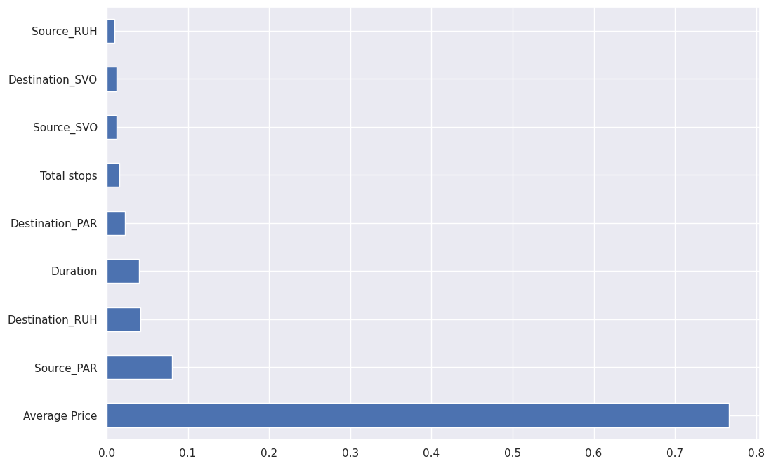
Features Importance
Notes:
After correlation, We wanted to assess the significance of different features in predicting the target variable, "Price," within the dataset. The Extra Trees Regressor , is used for this purpose. After fitting the model with the feature matrix (X) and the target variable (y), feature importance scores were computed.
These scores reflect the relative importance of each feature in predicting flight prices, with higher values indicating greater influence. This is horizontal bar plot showcasing the top 9 influential features, aiding in the visual identification of key factors affecting the model's predictive accuracy. The bars in the plot are arranged in descending order based on their importance scores, providing a clear understanding of the relative significance of each feature in predicting flight prices.
· We found that The most influential feature in predicting the flight price is the average price itself. This high importance score suggests that the average price has a substantial impact on determining the final flight price.
In conclusion Through correlation and feature importance analyses, we identified that the 'Average Price' feature is pivotal in forecasting flight prices, underscoring its significance in predictive models.

Slide 15
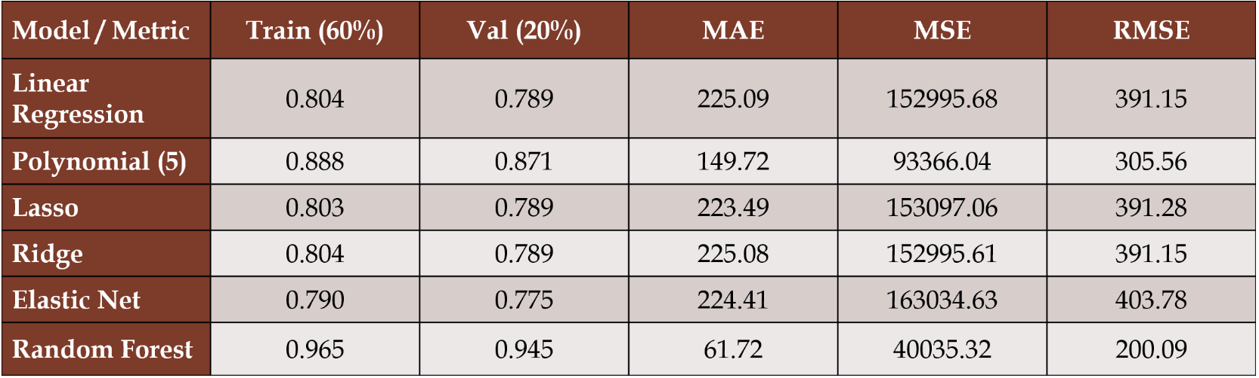
Experiments and Results
Notes:
We carefully divided the dataset into three parts: 60% for Training, 20% for Validation, and another 20% for Testing. This approach aimed to ensure robust model development and comprehensive evaluation.
Next, we embarked on a thorough evaluation of various regression models, aiming to uncover the best-suited model for predicting flight prices. On this slide, you'll find a concise summary of the Baseline Models Metrics for the regression models we examined.:
- Random Forest Regression outperforms, demonstrating robustness and high predictive accuracy.
- Polynomial regression improves with higher degrees but may lead to overfitting.
We then applied Feature scaling techniques to improve the performance of regression models, but no significant enhancement was observed, and adverse effects were noted for certain algorithms. Linear Regression showed no noticeable improvement, and scaling worsened results for Polynomial Regression.

Slide 16
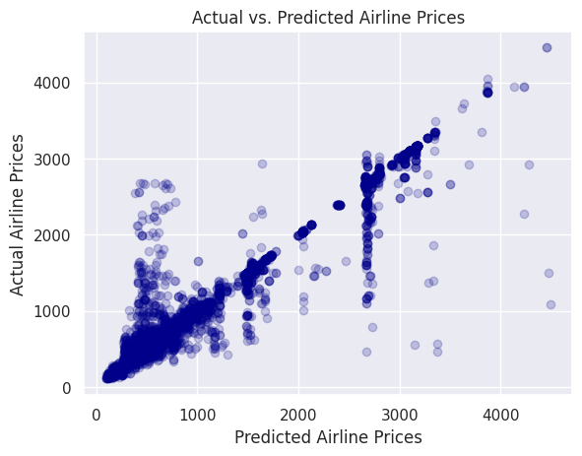
Retraining
Notes:
In the retraining phase, the Random Forest model underwent a process of enhancement by incorporating both the training and validation datasets. This amalgamation aimed to broaden the model's knowledge base, allowing it to glean insights from a more extensive pool of data. The objective was to improve the model's predictive capabilities by capturing a more generalized representation of underlying relationships between features and the target variable. Subsequently, the retrained model was evaluated using a separate test dataset to assess its performance on previously unseen data, ensuring its ability to make accurate predictions in real-world scenarios.
**Slide Title: "Retraining, Testing, and Hyperparameter Tuning"**
**1. Retraining:**
- Random Forest model retrained on combined training and validation datasets ('X_train' and 'X_val').
- Expanding model's knowledge base for better understanding of patterns and variations.
- Ensures a more generalized representation of relationships for improved performance on new data.
**2. Retrained Model Evaluation:**
- Model evaluated on separate test dataset ('X_test').
- Performance metrics:
- Train score: 0.9632
- Test score: 0.9459
- MAE: 61.87
- MSE: 40409.87
- RMSE: 201.02
**3. Hyperparameter Tuning:**
- Utilized Randomized Search CV to optimize Random Forest model's hyperparameters.
- Parameters tuned: 'n_estimators,' 'max_features,' 'max_depth,' 'min_samples_split,' 'min_samples_leaf.'
- Goal: Identify optimal combination enhancing model's predictive accuracy.
- Metrics:
- MAE: 64.19
- MSE: 41409.93
- RMSE: 203.49
**4. Tuning Impact:**
- Despite a thorough search, model's performance remained consistent.
- Indication that initial model configuration may already be near optimal settings.
**Conclusion:**
- Retraining and testing ensured robust performance on unseen data.
- Hyperparameter tuning, while performed comprehensively, did not significantly enhance predictive capability, suggesting the initial model configuration is already effective.

Slide 17
Hyperparameter Tuning
Notes:
Hyperparameter tuning is a crucial step in optimizing the performance of machine learning models, and in this case, it was applied to a Random Forest model. The process involved using Randomized Search CV to explore a predefined hyperparameter space, including parameters like the number of trees, maximum features for node splitting, maximum tree depth, minimum samples required to split a node, and minimum samples for a leaf node. The Randomized Search CV method rigorously evaluated various hyperparameter combinations through 5-fold cross-validation, aiming to identify the optimal set that minimizes mean squared error.

Slide 18
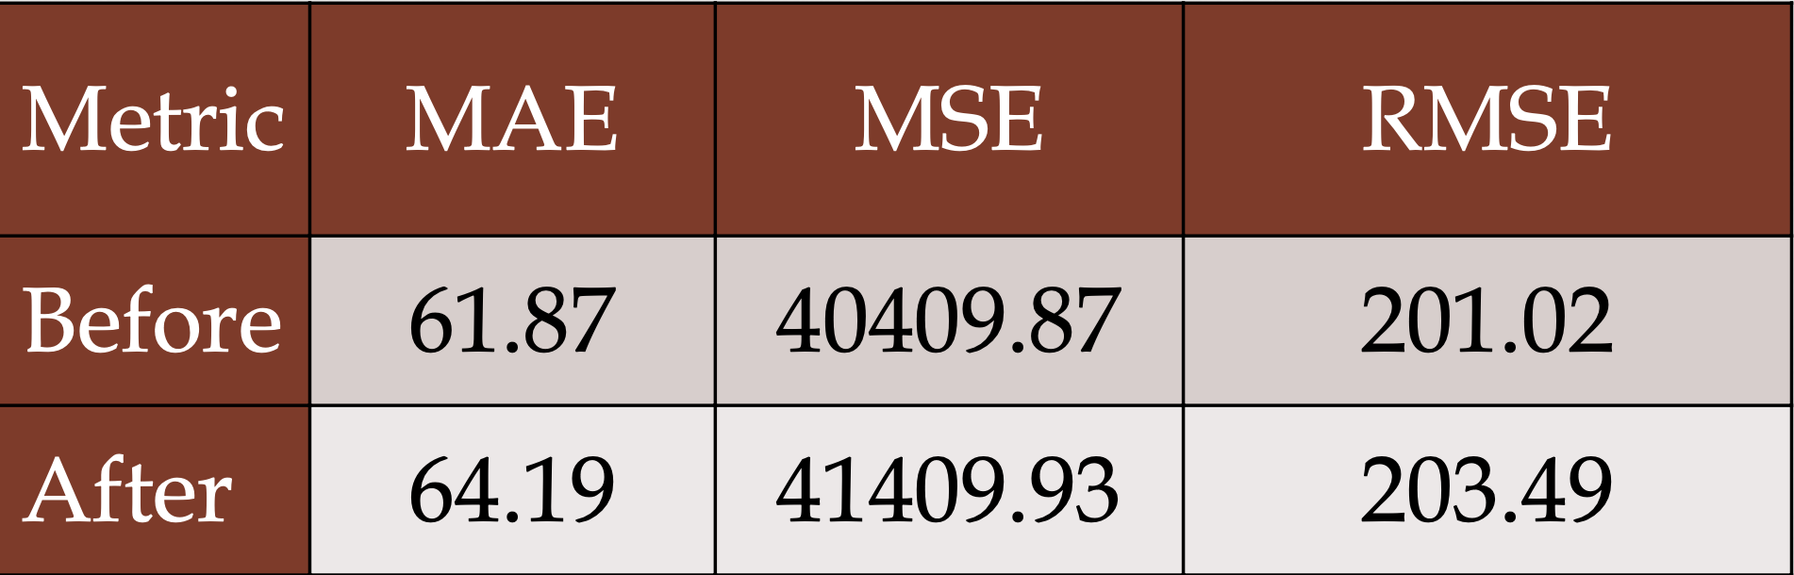
Results
Retraining the random forest model on train + val and scoring on test.
Before and after hyperparameter tuning using random search CV
Notes:
The study conducted an exhaustive exploration of various parameters within the model but found that the model's performance did not improve significantly despite the thorough search as shown in the slide. So, Randomized Search Cross-Validation iterations did not contribute to enhancing the model's predictive capability. This suggests that the initial configuration of the model may already be close to its optimal settings.

Slide 19
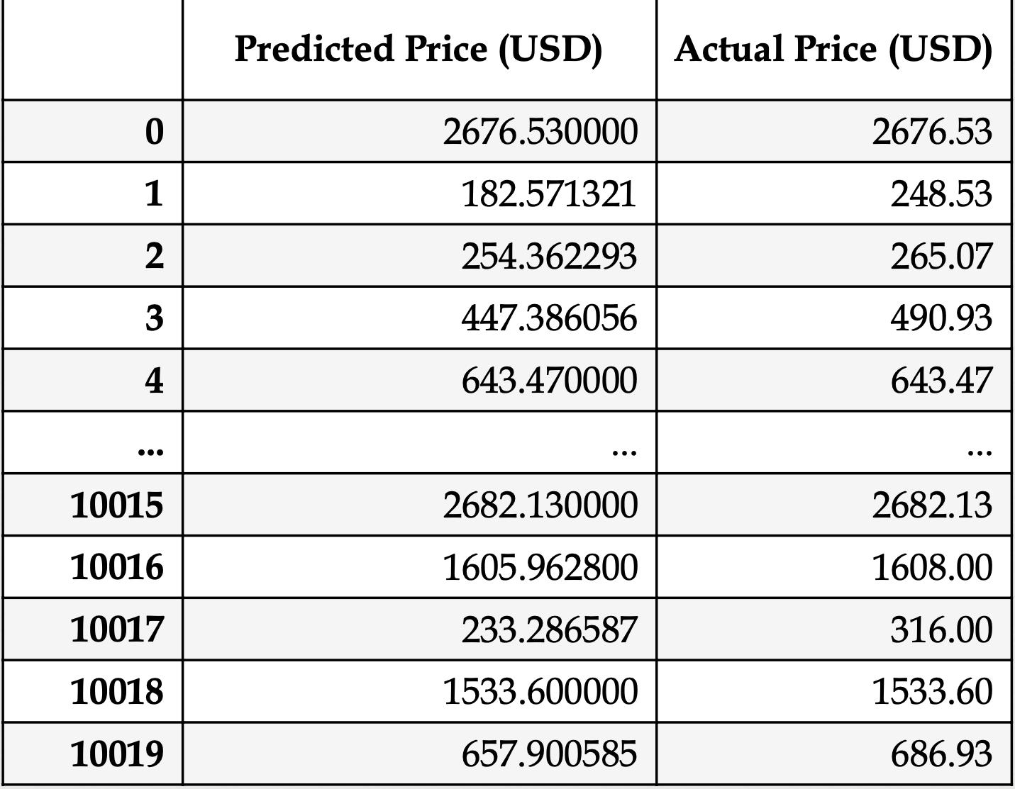
Model Evaluation
~ $61.87
Notes:
In conclusion, The RandomForestRegressor model displayed remarkable predictive performance in estimating flight ticket prices, achieving an impressive R2 of 0.945 on the test set. The model's proficiency was evident in lower error metrics, particularly the RMSE of $201.02. The final model showcased outstanding accuracy, predicting ticket prices within an approximate range of $61.87 on the test set. This was reaffirmed by a close examination of the 'Predicted Price' versus 'Actual Price' comparison, highlighting the model's exceptional ability to accurately estimate flight costs.

Slide 20
Future scope
Consider autocorrelation
More sources / destinations
Increase the period (dates)
Notes:
There are several areas where we could expand and refine our analysis:
1. Autocorrelation Consideration:
One aspect to delve into further is autocorrelation within our dataset. Exploring and understanding the temporal patterns and dependencies within the flight price data could provide valuable insights for predictive modeling.
2. Expanding Sources and Destinations:
Our analysis could benefit from incorporating a more extensive range of sources and destinations. Including additional airports or locations could render our predictive model more comprehensive and adaptable to a broader spectrum of flight routes.
3. Extending the Period:
Extending the time period covered in our dataset could offer deeper insights into seasonality, trend variations, and long-term patterns affecting flight prices. By analyzing data over a more extended period, we can capture more comprehensive trends and fluctuations.

